Slide 1
Lecture 9 – Dynamic Modeling (Part 1)
COMP 3700: Modeling and Design
Chapter 9: Dynamic Modeling
Gomaa, 2011

Slide 2
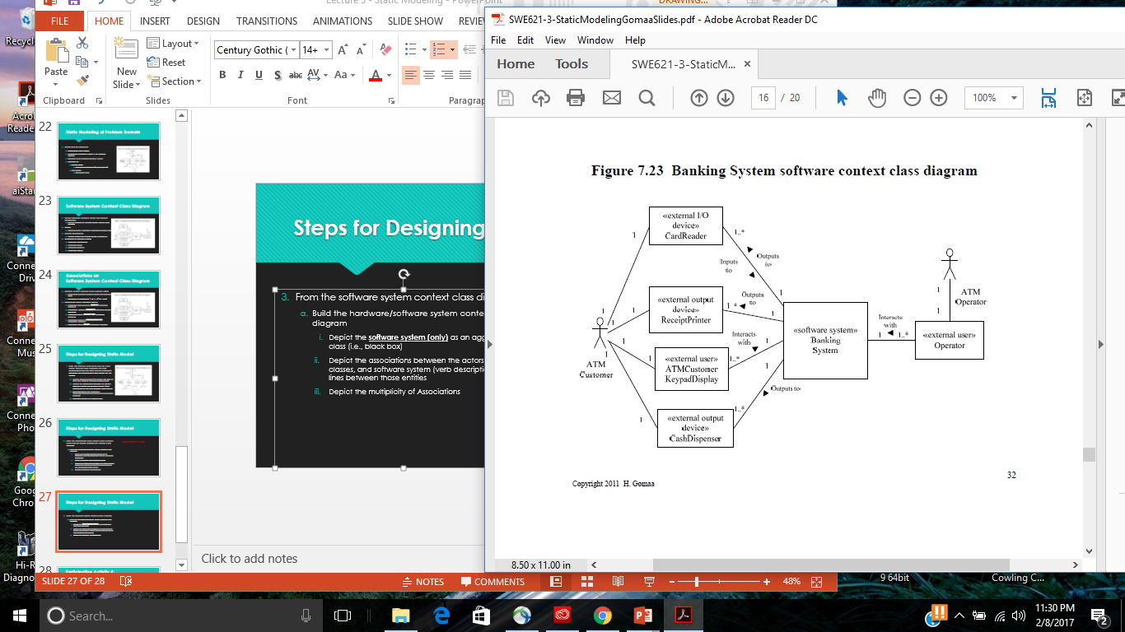
Entity Classes
Data intensive classes
Store long-living data (persistent)
Especially important for Information Systems
Many are database intensive
Also important for many real-time and distributed applications
COMET approach emphasizes static modeling of entity classes
During analysis modeling
Model entity classes in the problem domain
Attributes
Relationships

Slide 3
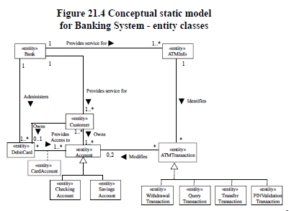
Moving into the Black Box
This phase focuses on understanding the problem domain/description from the perspective of the software
Understanding entities of the software that are likely not to change.
Start from the problem description
Identify static (i.e., unlikely to change) entities identified in the problem description
Model them as classes with the stereotype <<entity>>
Depict the associations between the entity classes (verb descriptions on the lines) between those classes
Depict the multiplicity of associations
For each class, describe attributes and attribute types using class UML notation

Slide 4
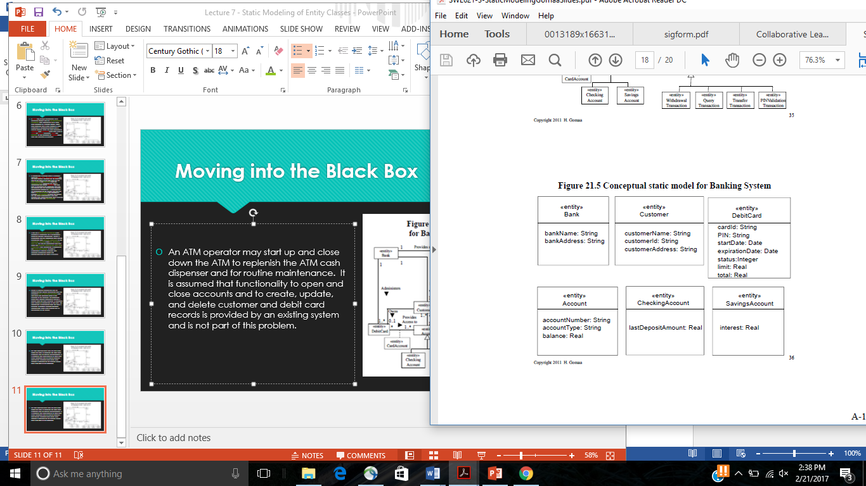
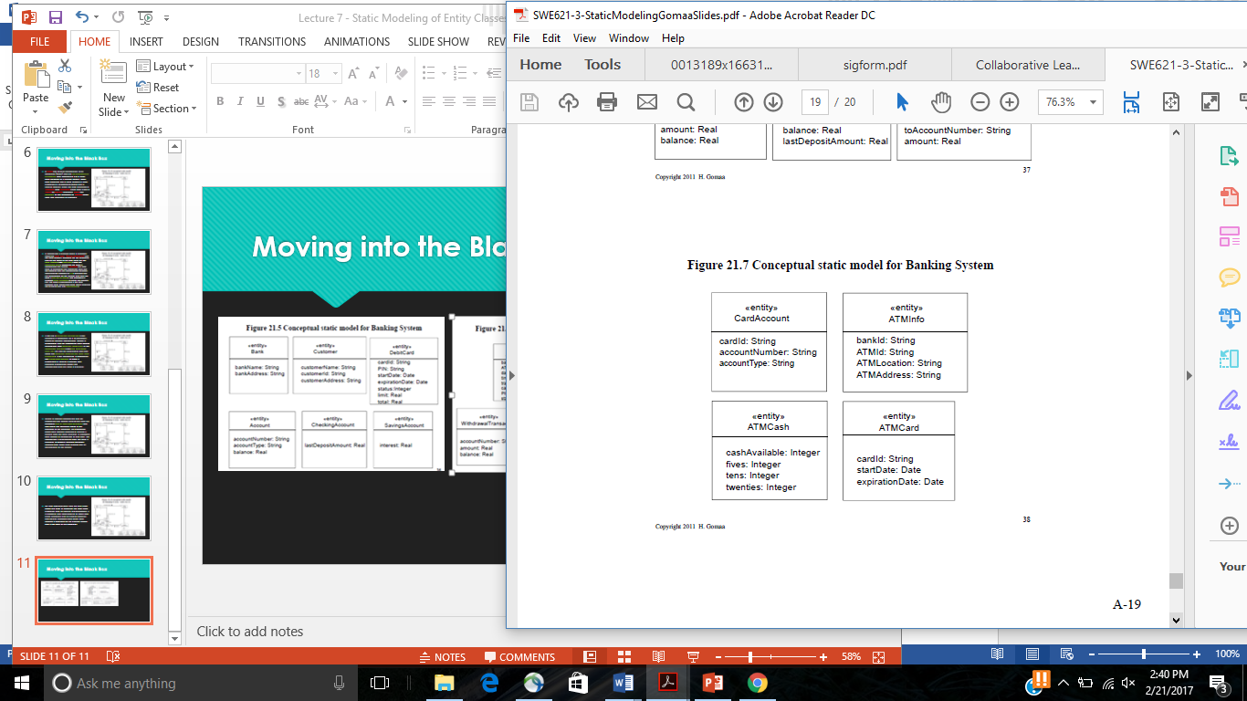
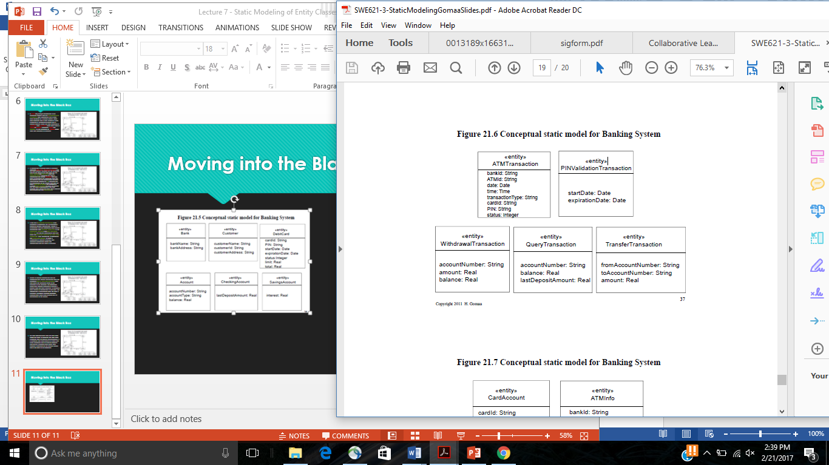
Moving into the Black Box

Slide 5
Participation Activity 6 Entity class diagram and class attributes
Remaining in in-class groups, create the entity class diagram for the software system depicted as a black box in your software context class diagram
Upload into Canvas
Entity class diagram with stereotypes
UML classes with class attributes (including types) with stereotypes
Reminder: Exam 2 is Thursday (2/23) in class

Slide 6
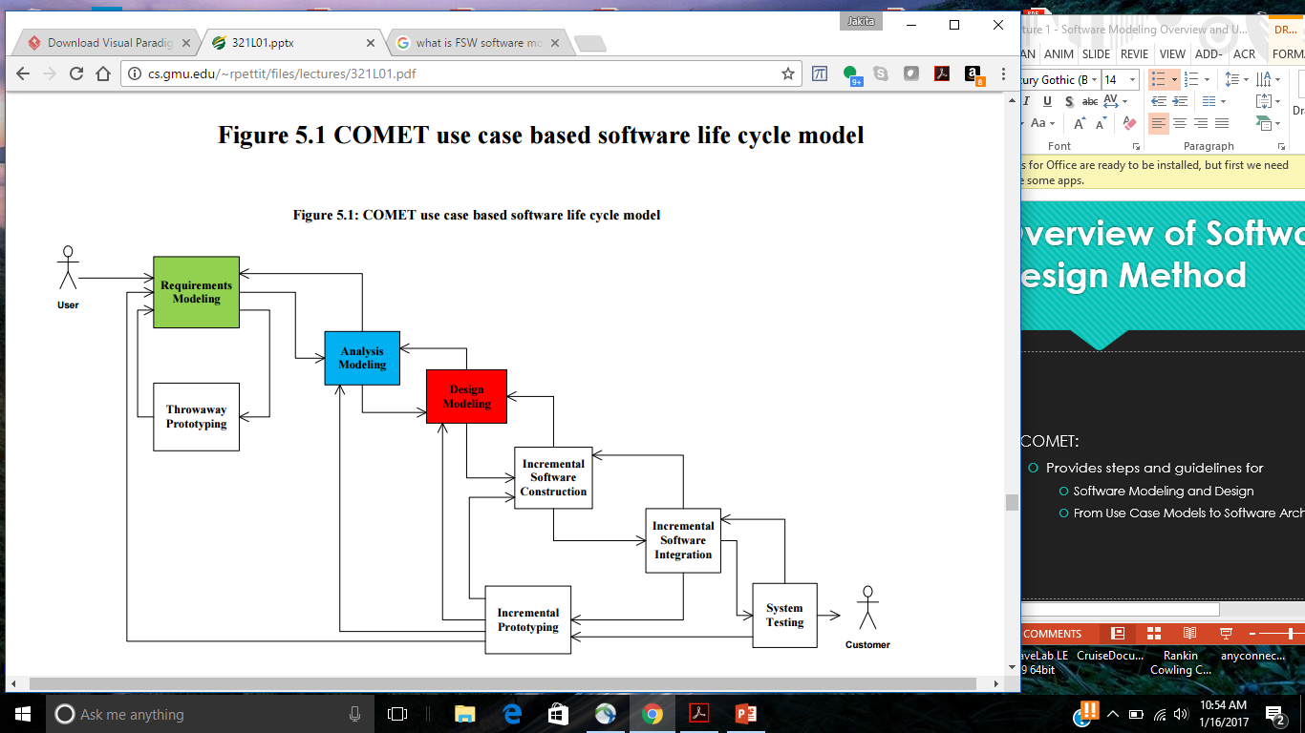
COMET Use Case Based Software Life Cycle Model
Develop Software Requirements Model
Develop Use Case Model (Chapter 6)
Develop Software Analysis Model
Develop Static model of problem domain (Chapter 7)*
Structure system into objects (Chapter 8)
Develop statecharts for state dependent objects (Chapter 10)
Develop object interaction diagrams for each use case (Chapter 9, 11)

Slide 7
Dynamic Modeling
Use cases realized in Dynamic Model
Show objects participating in each use case
Determine how objects participate in use case
Use object structuring criteria to determine objects
Stereotype for each object structuring criterion
Shows sequence of object interactions in use case
Depict on
Communication diagram OR
Sequence diagram
State dependent control objects
Modeled using statecharts
Dynamic Modeling
Approach to determine how objects interact with each other to support use case

Slide 8
Steps for Dynamic Modeling
Determine how objects interact with each other to support use case (called object interaction modeling)
Start with external event from actor (i.e., main path through use case description (scenario))
Determine objects needed to support use case scenario (using object structuring criteria – Chapter 8)
Depict the system external classes and boundary classes (Chapter 8)
Determine sequence of messages between the steps in the use case scenario
Depict on communication diagram or sequence diagram (also called interaction diagram)
Repeat steps 1 – 4 for each alternate path (articulated in the use case description)
Stateless Dynamic Modeling
State dependent Dynamic Modeling
Important for real-time design

Slide 9
COMET: Analysis and Design Decisions in Object Interaction Modeling
In COMET
Emphasis during analysis modeling is on capturing the information passed between objects, rather than on the operations invoked
Operations are postponed until the design phase
Kind of messaging is postponed until the design phase
Synchronous or Asynchronous
Preference is to use communication diagram rather than sequence diagram
An important step in the transition to design is the integration of the communications diagrams to create the initial software architecture of the system
That integration is much easier with communications diagrams than with sequence diagrams

Slide 10
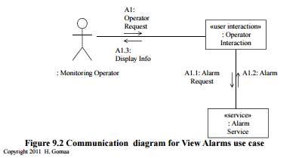
Dynamic Modeling: Communication Diagram
Graphically depicts objects interacting with each other
Shows objects as boxes
Show their message interactions as arrows
Number sequence of messages

Slide 11
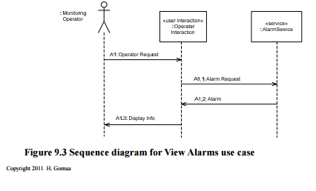
Dynamic Modeling: Sequence Diagram
Shows sequence of object interactions in use case
Emphasis on messages passed between objects
Objects represented by vertical lines
Messages represented by labeled horizontal arrows

Slide 12
Dynamic Modeling: Step 1
Determine how objects interact with each other to support use case (called object interaction modeling)
Start with external event from actor (i.e., main path through use case description (scenario))
Determine objects needed to support use case scenario (using object structuring criteria – Chapter 8)
Depict the system external classes and boundary classes (Chapter 8)
Determine sequence of messages between the steps in the use case scenario
Depict on communication diagram or sequence diagram (also called interaction diagram)
Repeat steps 1 – 4 for each alternate path (articulated in the use case description)

Slide 13
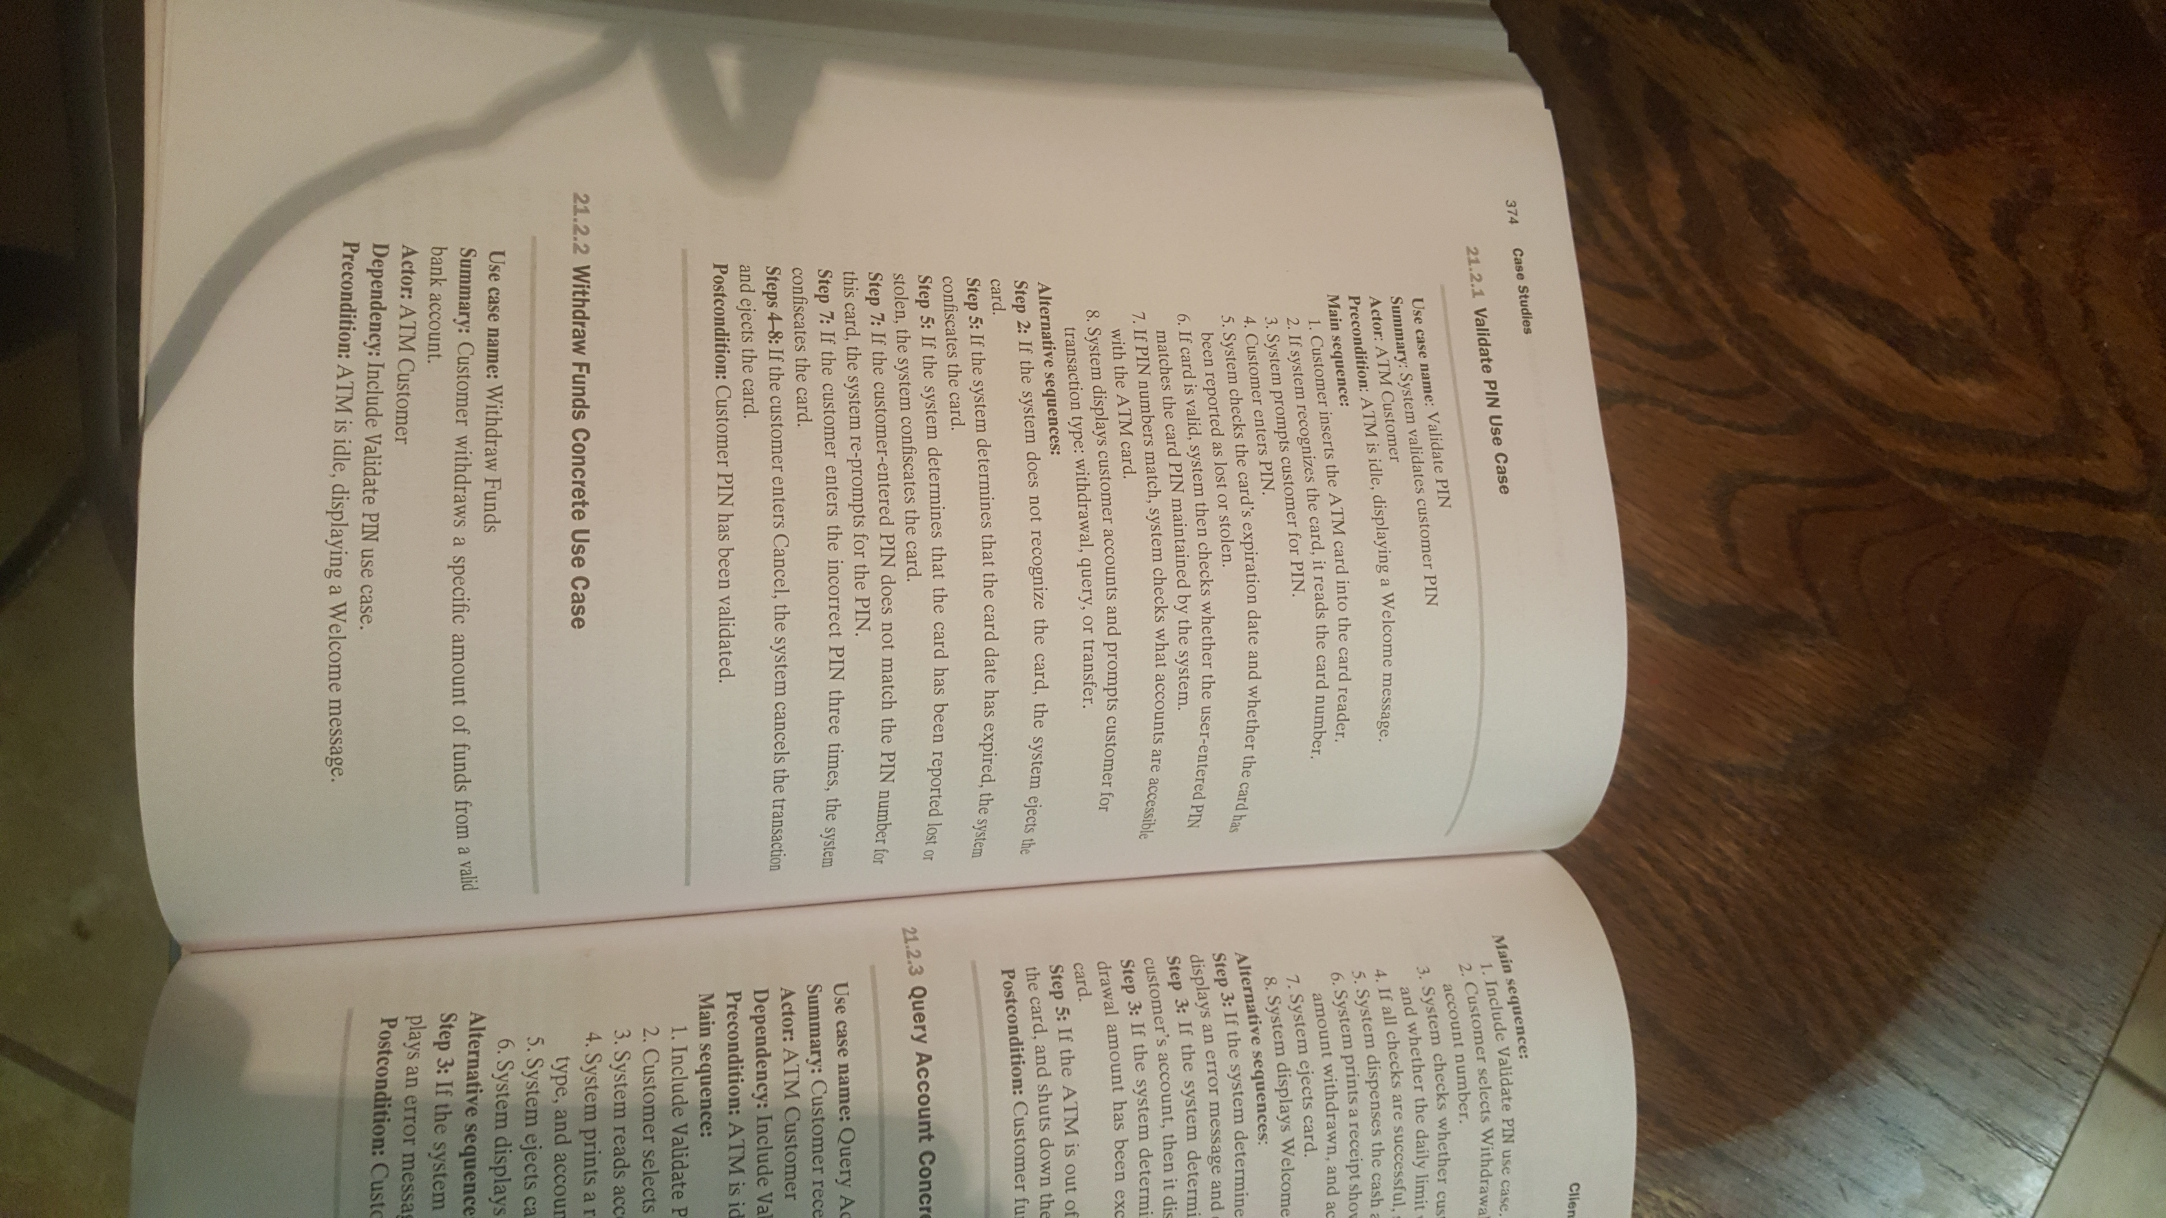
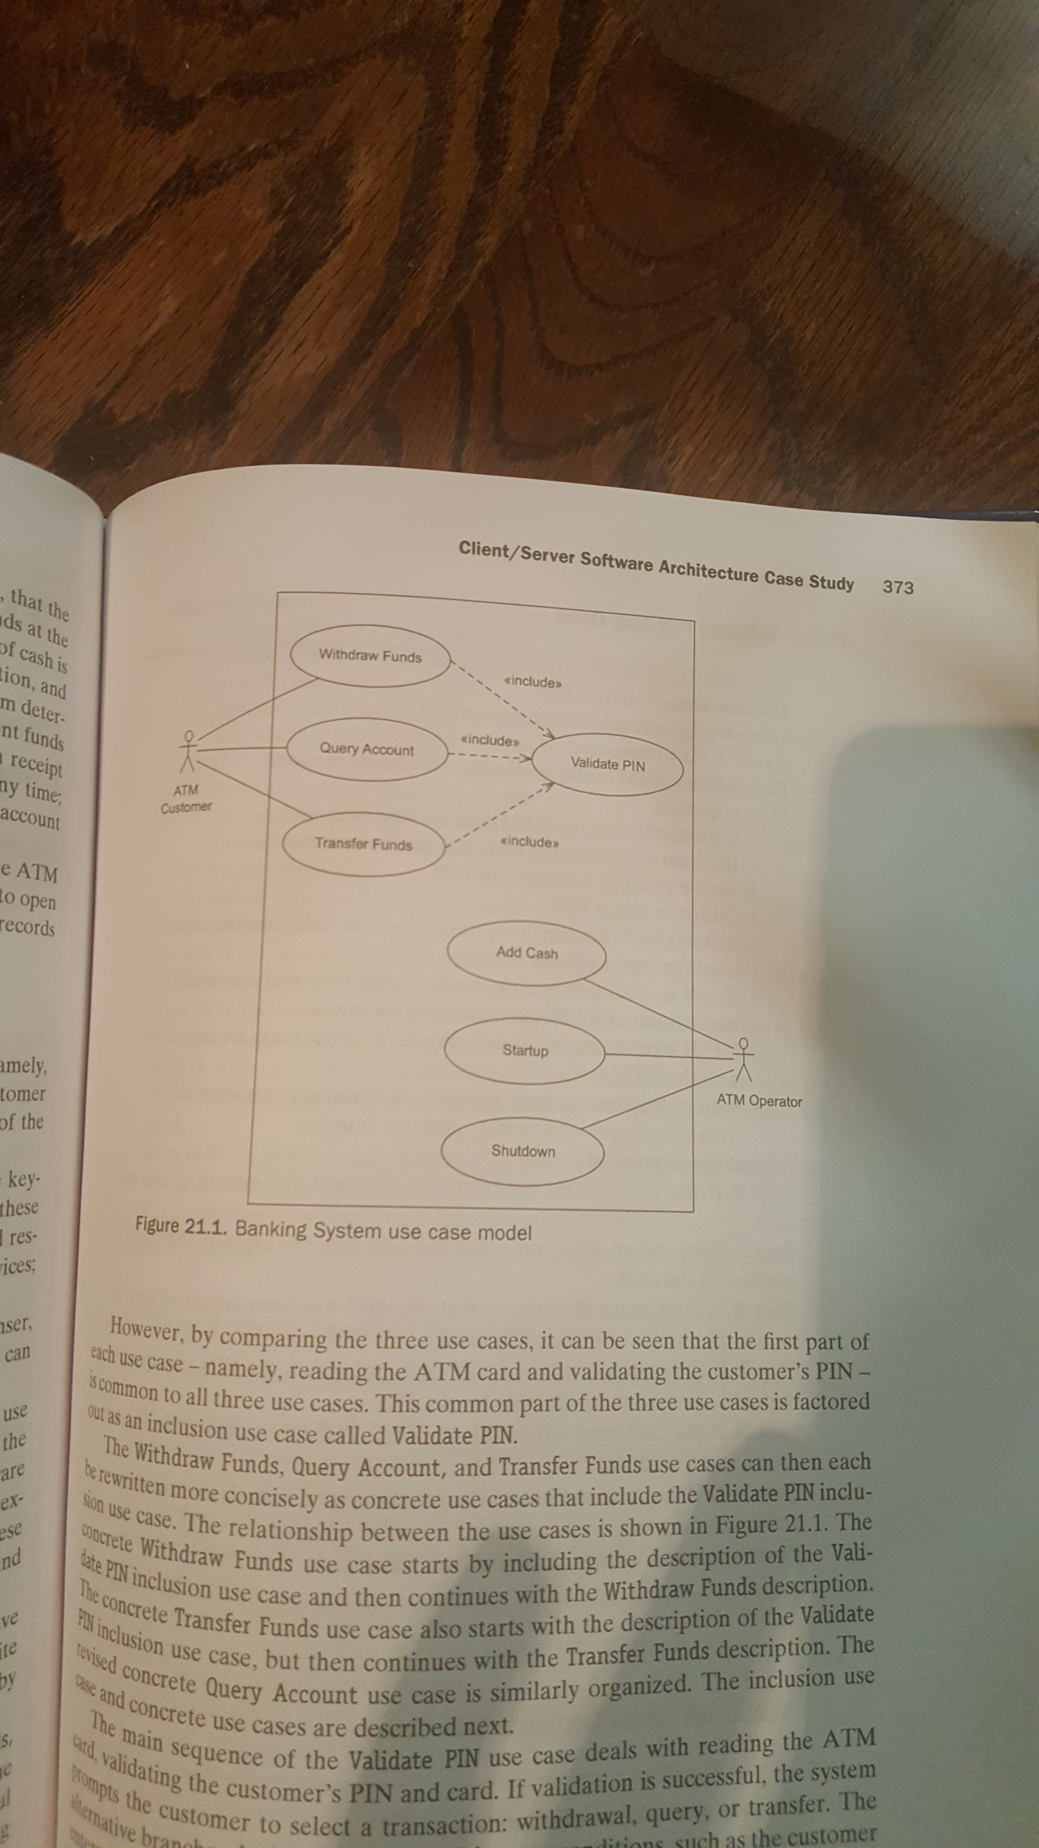
Start with external event from actor
Main path through use case description (called a use case scenario) for a particular use case

Slide 14
Dynamic Modeling: Step 2
Determine how objects interact with each other to support use case (called object interaction modeling)
Start with external event from actor (i.e., main path through use case description (scenario))
Determine objects needed to support use case scenario (using object structuring criteria – Chapter 8)
Depict the system external classes and boundary classes (Chapter 8)
Determine sequence of messages between the steps in the use case scenario
Depict on communication diagram or sequence diagram (also called interaction diagram)
Repeat steps 1 – 4 for each alternate path (articulated in the use case description)

Slide 15
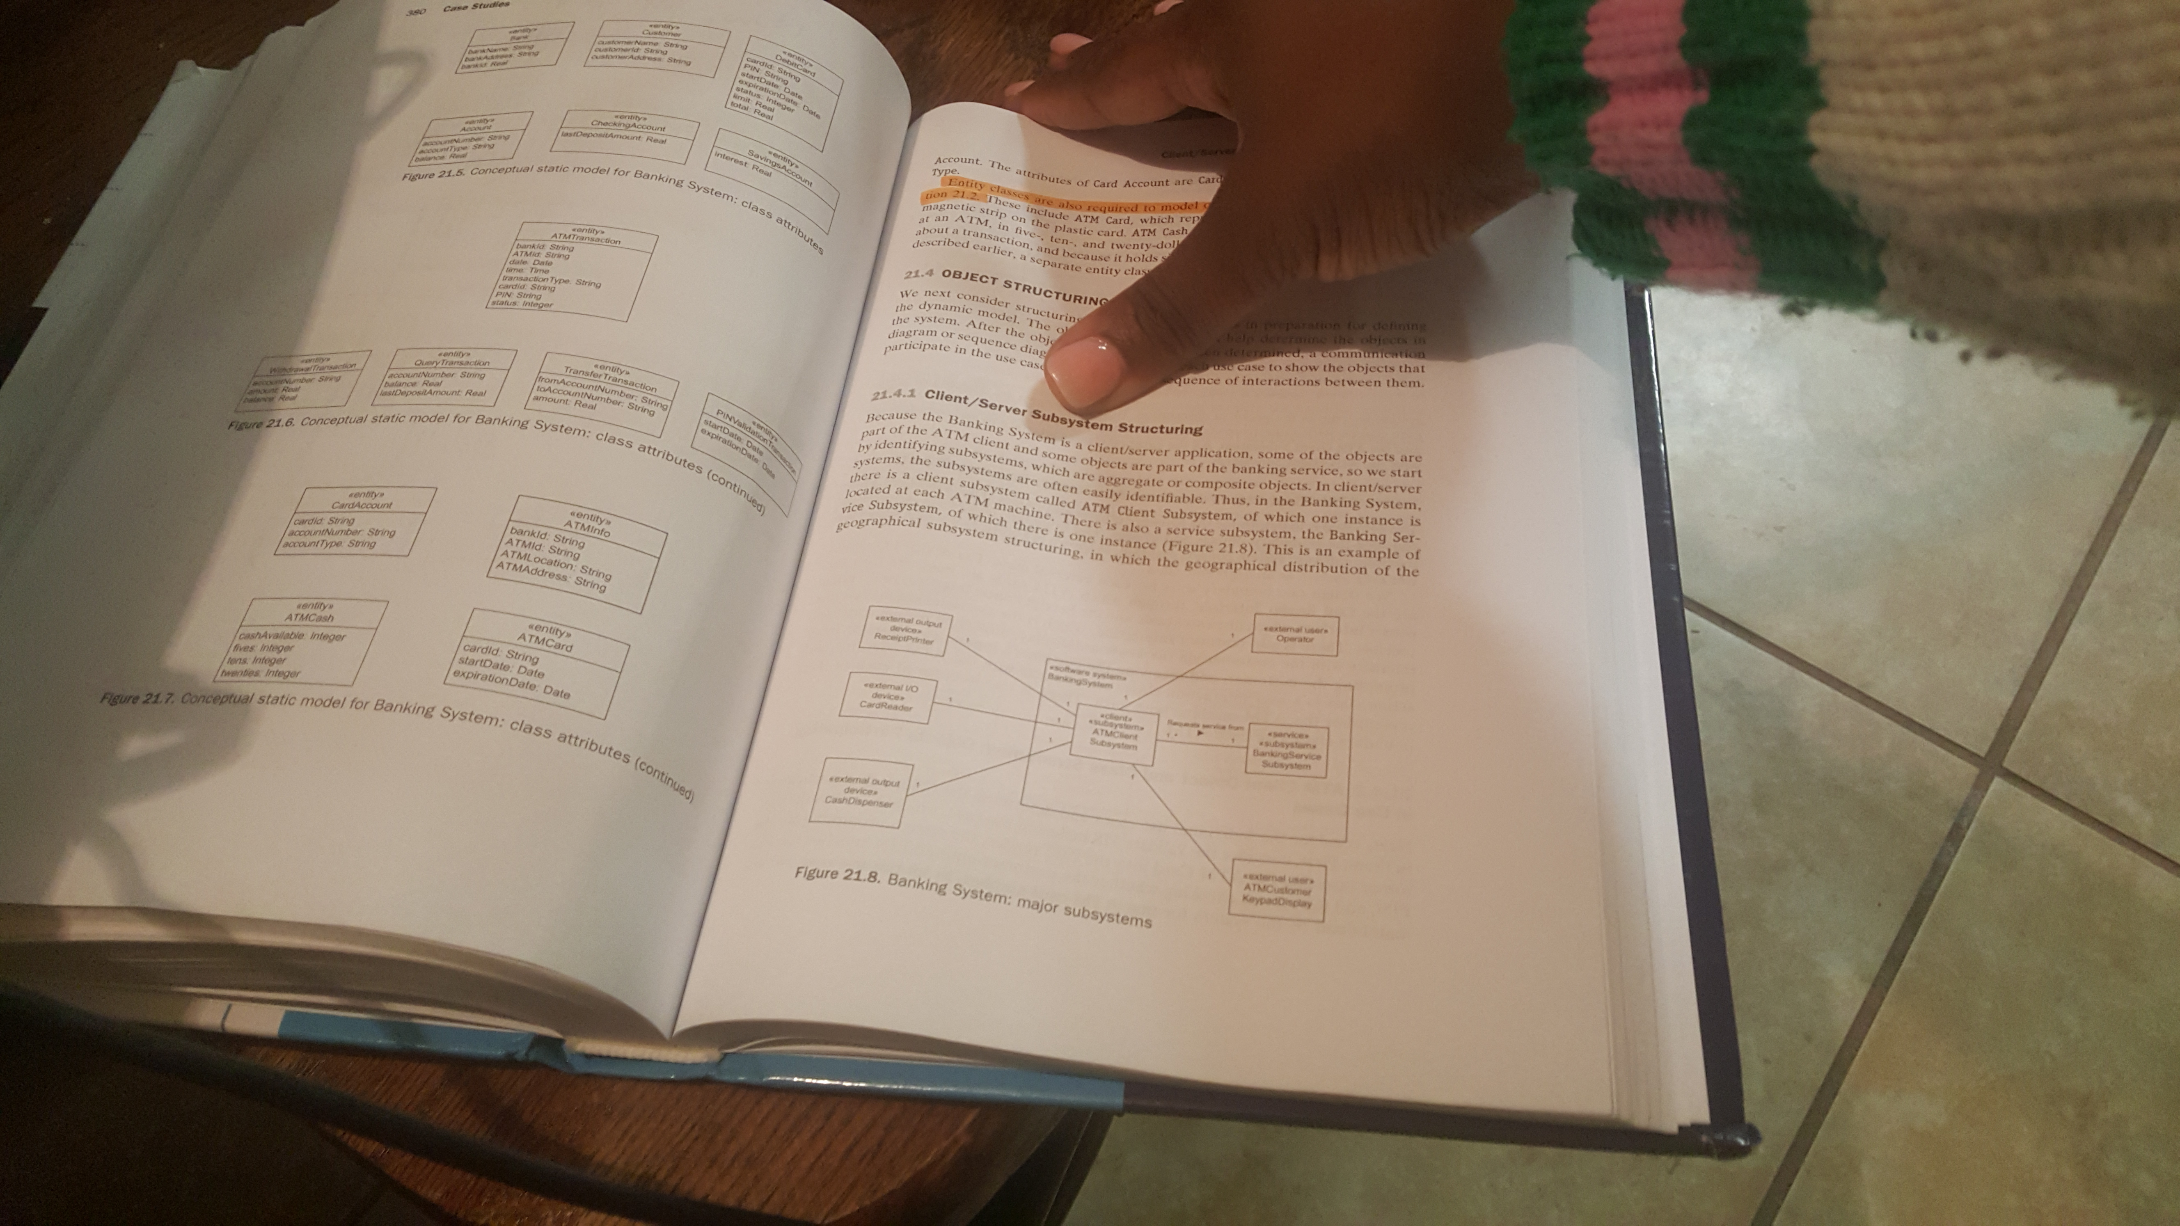
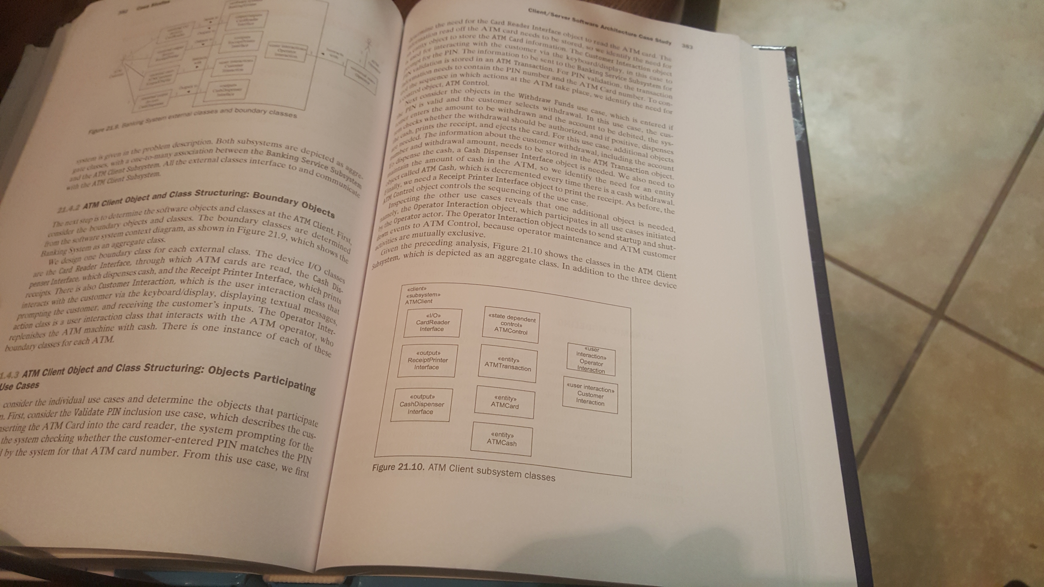
Determine objects needed to support use case scenario (Chapter 8)
Use object structuring criteria

Slide 16
Dynamic Modeling: Step 3
Determine how objects interact with each other to support use case (called object interaction modeling)
Start with external event from actor (i.e., main path through use case description (scenario))
Determine objects needed to support use case scenario (using object structuring criteria – Chapter 8)
Depict the system external classes and boundary classes (Chapter 8)
Determine sequence of messages between the steps in the use case scenario
Depict on communication diagram or sequence diagram (also called interaction diagram)
Repeat steps 1 – 4 for each alternate path (articulated in the use case description)

Slide 17
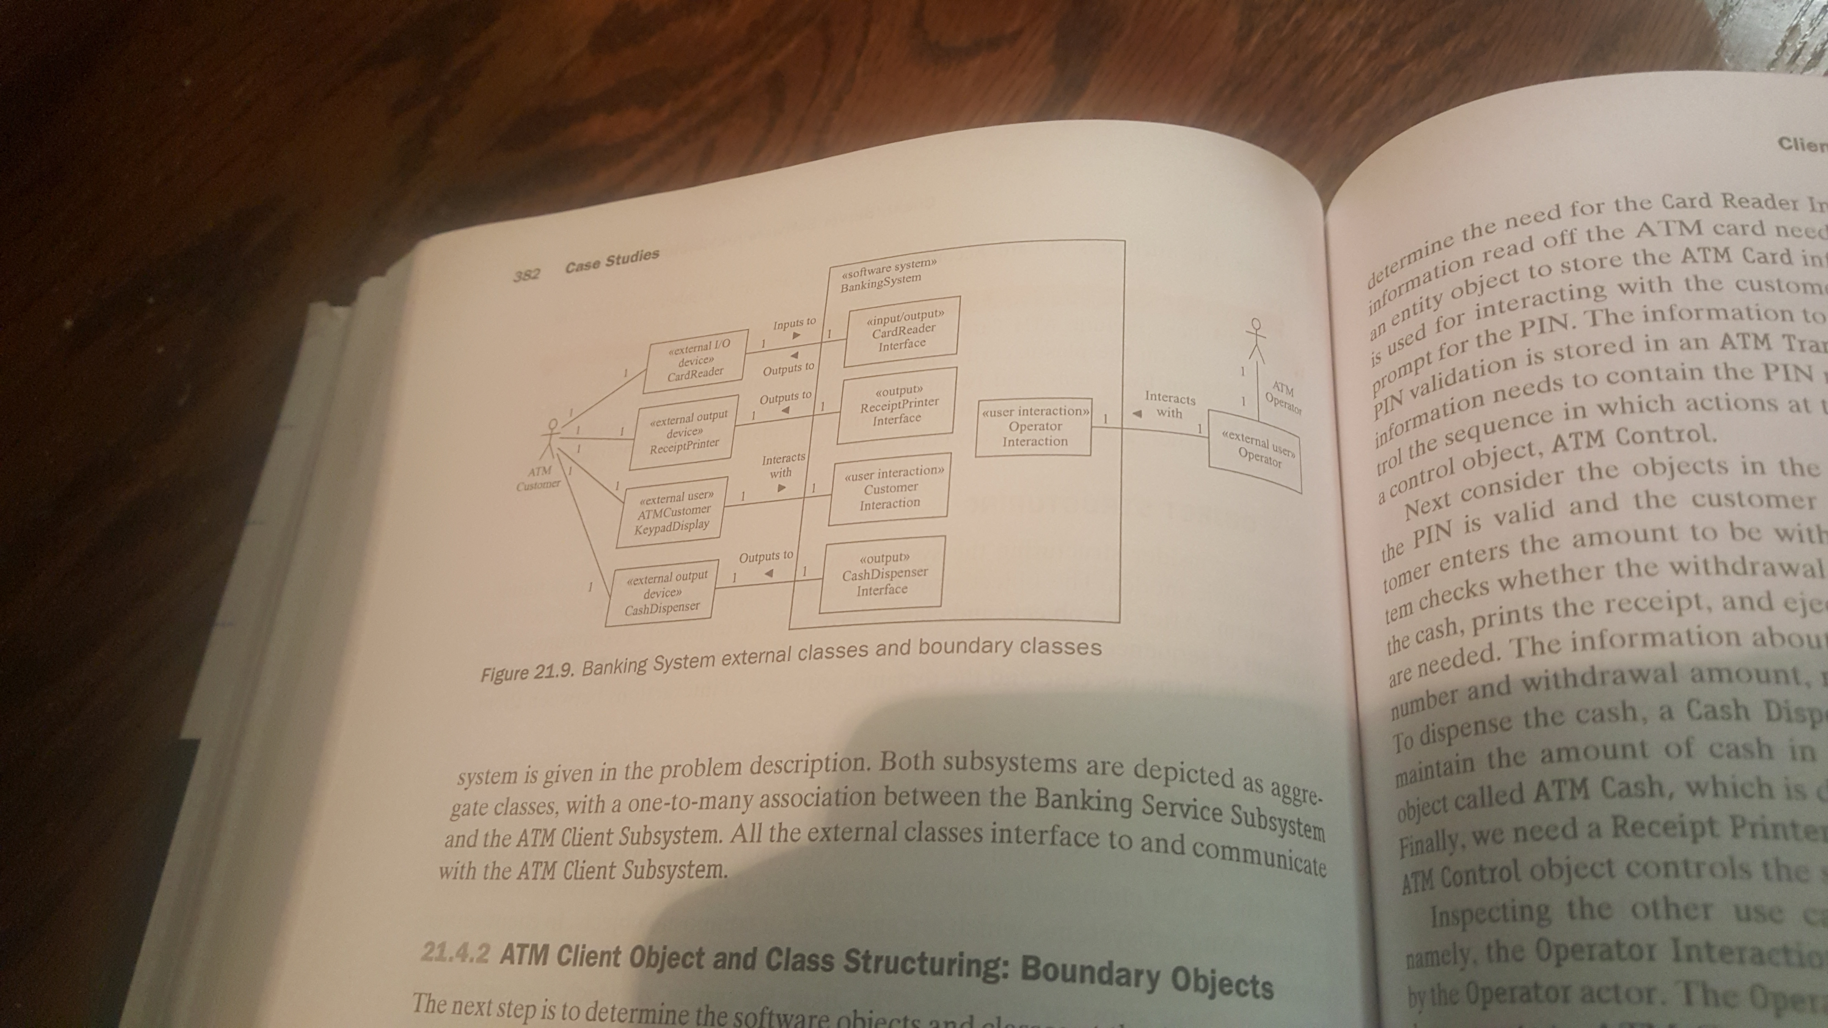
Depict the system external classes and boundary classes (Chapter 8)
Start from system context class diagram
Depict boundary classes (NOTE: each external class must interface to software boundary class)
Depict relationship(s) between external classes and boundary classes
Describe the associations between external class(es) and boundary class(es) (i.e., verbs on the lines)
Depict multiplicity of associations

Slide 18
Dynamic Modeling: Steps 4 & 5
Determine how objects interact with each other to support use case (called object interaction modeling)
Start with external event from actor (i.e., main path through use case description (scenario))
Determine objects needed to support use case scenario (using object structuring criteria – Chapter 8)
Depict the system external classes and boundary classes (Chapter 8)
Determine sequence of messages between the steps in the use case scenario
Depict on communication diagram or sequence diagram (also called interaction diagram)
Repeat steps 1 – 4 for each alternate path (articulated in the use case description)

Slide 19
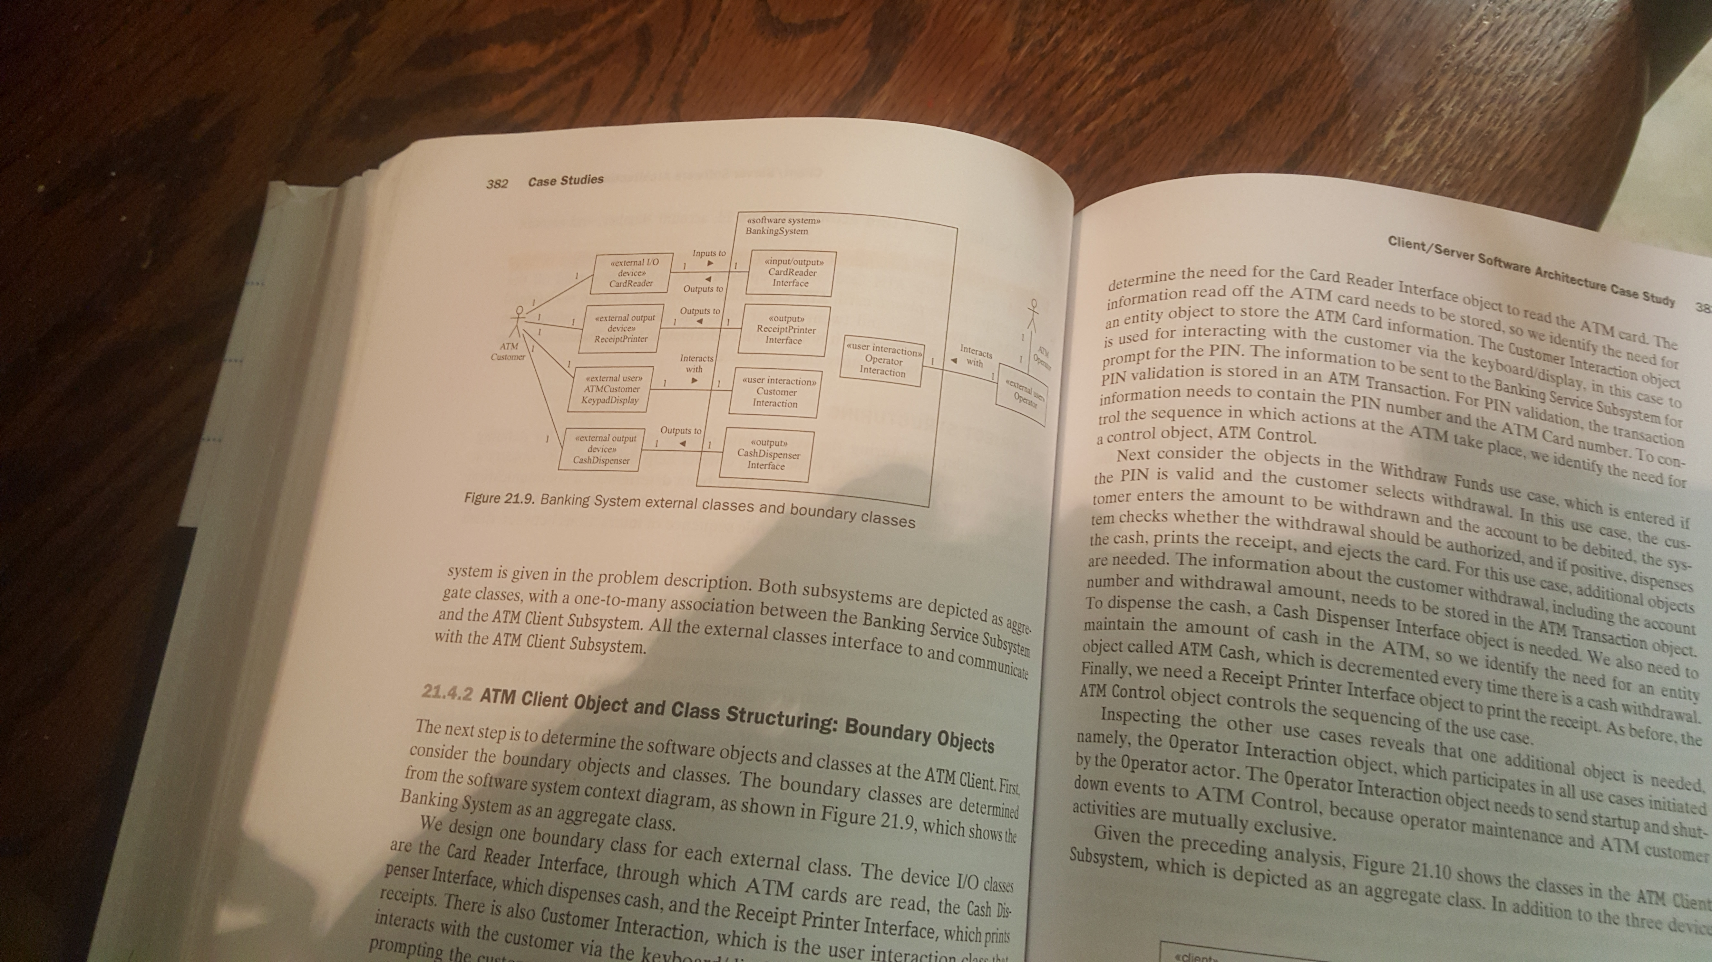
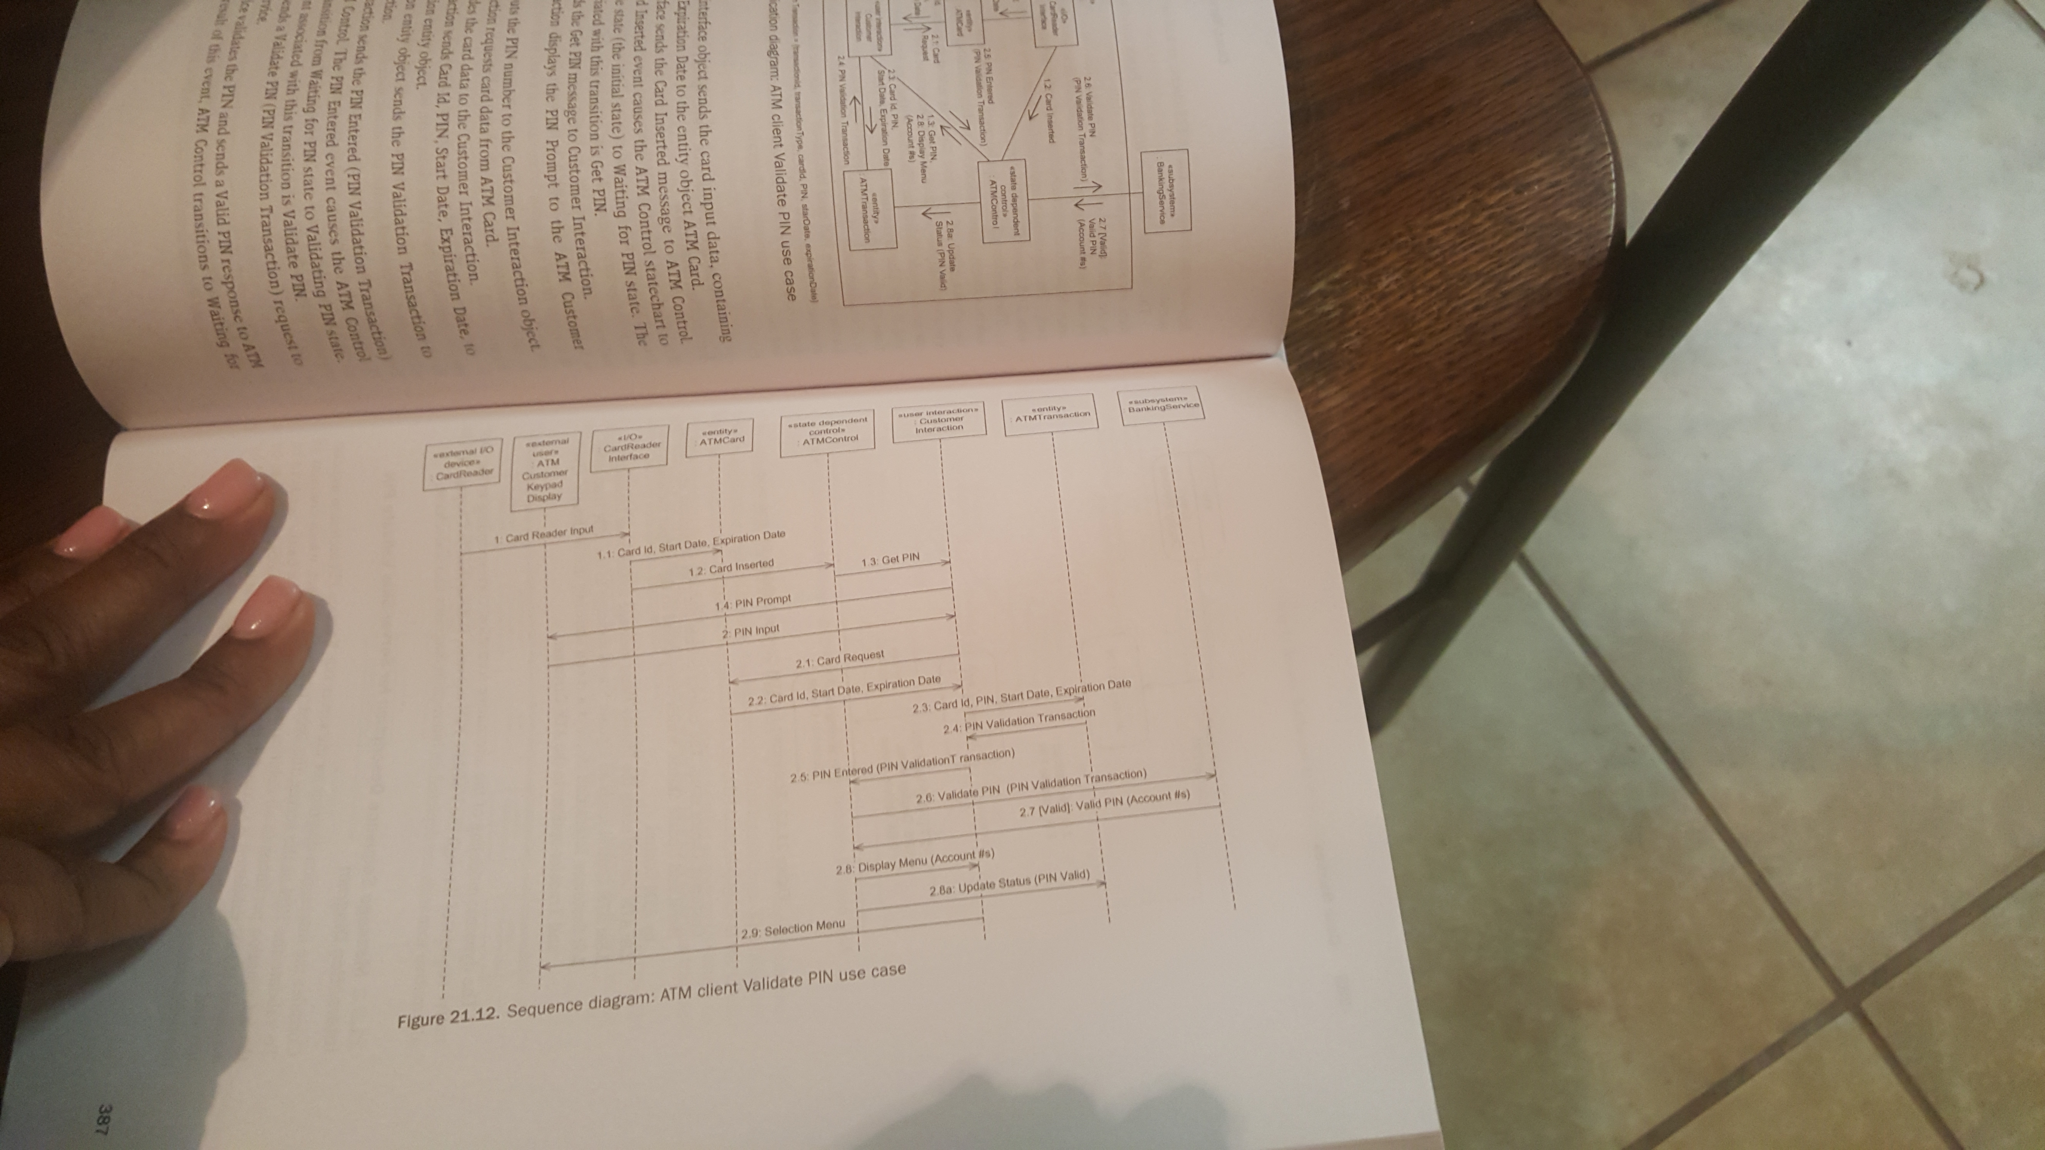
Depict sequence of messages on interaction diagram
Communication or sequence

Slide 20
Dynamic Modeling: Step 6
Determine how objects interact with each other to support use case (called object interaction modeling)
Start with external event from actor (i.e., main path through use case description (scenario))
Determine objects needed to support use case scenario (using object structuring criteria – Chapter 8)
Depict the system external classes and boundary classes (Chapter 8)
Determine sequence of messages between the steps in the use case scenario
Depict on communication diagram or sequence diagram (also called interaction diagram)
Repeat steps 1 – 4 for each alternate path (articulated in the use case description)

Slide 21
Participation Activity 7 & Preparation Activity 8: Interaction Diagrams
Remaining in in-class groups, choose a use case scenario from your use case model of the Shelby County Bill Pay System
Follow the six steps to create a set of interaction diagrams for that scenario and it’s alternative paths
Diagrams can be either communication diagrams or sequence diagrams
Upload into Canvas
The use case scenario (i.e., use case description)
Interaction Diagrams
Please come prepared on Tuesday to peer review each other’s interaction diagrams
You’ll need to have available/bring/print
Use case scenario
Interaction diagrams for that use case scenario

